Slide 1
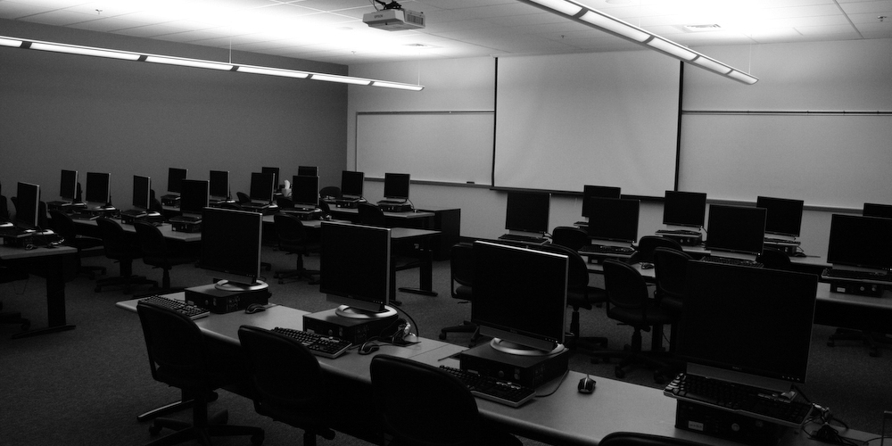
Equipment Replacement & Support
Information Technology Services
Board Retreat – February 7, 2009

Slide 2


The Challenge?
Continuous growth of computers, printers & smart classrooms. Purchased primarily with bond funds or one-time monies
Increasing role of technology in the District mission. Instruction, communication, business processes and cost savings …
No existing strategy or funding mechanism for replacement as equipment becomes obsolete
Resulting in –
    Instructional programs that will not
    be competitive
    Increasing demand on ITS for repair
    services and support
    Increasing funding for replacement
    parts

Slide 3
Growth of Computers by College
4,443

Slide 4
Computer Distribution – Feb. 2009
Skyline
  Labs 761
  Assigned 589
Cañada
  Labs 919
  Assigned 218
CSM
  Labs 1238
  Assigned 562
District Total = 4,443

Slide 5
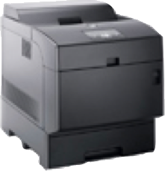
Printer Distribution – Feb. 2009
Printer Distribution
District Total = 1134

Slide 6
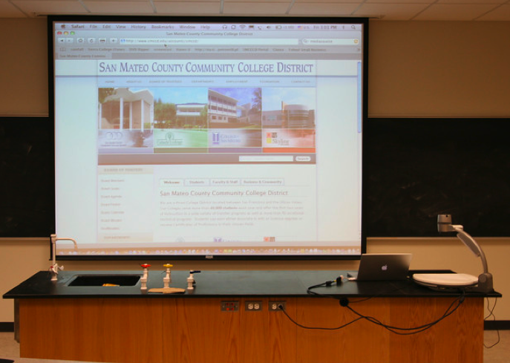
Increasing Smart Classrooms
229

Slide 7
Smart Classroom Distribution
District Total = 229

Slide 8
Desktop Support Staff
Workstations Per Technician
Cañada
CSM & D.O
Skyline
Chancellor’s Office 2004-05 TCO Recommendation – 150 computers/Technician

Slide 9
Estimated Value of IT Equipment
Equipment | Estimated Value
Computers | $9,330,300
Printers | $475,000
Network | $4,500,000
Servers | $3,750,000
Telephone System | $2,300,00
Smart Classrooms | $1,488,500
Total | $21,843,800

Slide 10
5-Year Computer Replacement Schedule
 | 2009-10 | 2010-11 | 2011-12 | 2012-13 | 2013-14
Cañada | 53 | 248 | 449 | 211 | 222
 | $111,300 | $520,800 | $942,900 | $443,100 | $466,200
CSM | 609 | 164 | 478 | 325 | 248
 | $1,280,000 | $344,400 | $1,003,000 | $682,500 | $520,800
Skyline | 336 | 183 | 334 | 267 | 241
 | $705,600 | $384,300 | $701,400 | $560,700 | $506,100
D.O. | 28 | 7 | 14 | 14 | 91
 | $58,800 | $14,700 | $29,400 | $29,400 | $191,100
Subtotal | 1026 | 602 | 1275 | 817 | 802
 | $2,156,726 | $1,264,200 | $2,676,700 | $1,715,700 | $1,684,200

Slide 11
5-Year Infrastructure Replacement Schedule
Equipment | 2009-10 | 2010-11 | 2011-12 | 2012-13 | 2013-14
Network | $150,000 | $175,000 | $175,000 | $400,000 | $400,000
Telephone System |  |  |  |  | $2,200,000
Servers |  | $150,000 | $300,000 | $150,000 | $100,000
Smart Classrooms | $22,500 | $45,000 | $135,000 | $337,500 | $490,500
Subtotal | $172,500 | $370,000 | $610,000 | $887,500 | $3,190,500

Slide 12
Estimated Cost of 5-Year Replacement Schedule
Districtwide
 | 2009-10 | 2010-11 | 2011-12 | 2012-13 | 2013-14
Cañada | $111,300 | $520,800 | $942,900 | $443,100 | $466,200
CSM | $1,280,000 | $344,400 | $1,003,000 | $682,500 | $520,800
Skyline | $705,600 | $384,300 | $701,400 | $560,700 | $506,100
D.O | $58,800 | $14,700 | $29,400 | $29,400 | $191,100
Districtwide | $172,500 | $370,000 | $610,000 | $887,500 | $3,190,500
Total | $2,328,200 | $1,634,200 | $3,286,700 | $2,603,200 | $4,874,700
Grand Total for the 5 Year Period – $14,727,000

Slide 13

How Can This Be Funded?

