Slide 1
2025-2028 Student Equity and Achievement Plan (SEAP)
First Draft
David Galvez, Director of Equity
Oct 13, 2025

Slide 2
Agenda
Overview
01
Baseline Date, Key DI Populations, and Target Metrics
02
Equity Gaps and Root Causes
03
SEAP Priorities and Goals
04
Coordination with Existing Plans
05

Slide 3
2025 CSM SEAP Plan:
Overview
25-28 CSM SEAP First Draft

Slide 4
Overview
The 2025-2028 CSM SEAP plan outlines FOUR major goals:
Close equity gaps for DI student populations:
  Black or African American (Successful Enrolment)
  Latinx (Transfer Level Math and English)
  Filipinx (Transfer)
  Economically Disadvantaged Female (Transfer Level Math and English)
  First Generation (Transfer Level Math and English, Persistence, Completion)
  DSPS (Transfer Level Math and English and Completion)
  Female (Transfer-Level Math and English)
  Male (Completion)
Improve sense of belonging, engagement, and academic success for DI student populations.
Strengthen academic and student support service infrastructure for DI student populations.
Build institutional capacity for equity-centered professional learning.

Slide 5
2025 CSM SEAP Plan:
Baseline Date, Key DI Populations, and Target Metrics
25-28 CSM SEAP First Draft

Slide 6

Before we Begin: Disproportionate Impact
Disproportionate Impact (DI)
Disproportionate impact refers to a situation in which a subgroup of students (e.g. by race, gender, disability status, etc.) attains a particular outcome at a substantially lower rate than a reference group (or the system-wide rate), that suggests inequitable practices, policies, or barriers.
In other words: some students are “disproportionately impacted” when their access, progress, or success is impeded relative to peers, not explainable by legitimate differences.
Measurement
The CCCCO (Chancellor’s Office) provides guidance on standard methods to detect disproportionate impact, for example:
The 80% rule (a subgroup’s rate is less than 80% of the best-performing group)
The point-gap method (percentage point difference vs. overall or reference rate)

Slide 7
Before we Begin: Equity Gap
Equity Gap
An equity gap is the magnitude of the disparity in outcomes between a subgroup and a reference or benchmark level (often the system average or highest group).
It captures how far behind a subgroup is. In CCC’s framework, the “Percentage Point Gap minus 1 (PPG-1)” method is commonly used to compute equity gaps.
In short: while DI flags that a group is significantly underperforming, the equity gap quantifies how much improvement would be needed to bring that group up to parity (or to eliminate the disparity).
Use in planning:
  After identifying DI groups, colleges use equity gap measures to set more ambitious goals: not just eliminating DI but narrowing and ultimately eliminating the gap.
  Closing the equity gap is often framed as a longer-term or aspirational goal beyond immediate corrective actions.

Slide 8
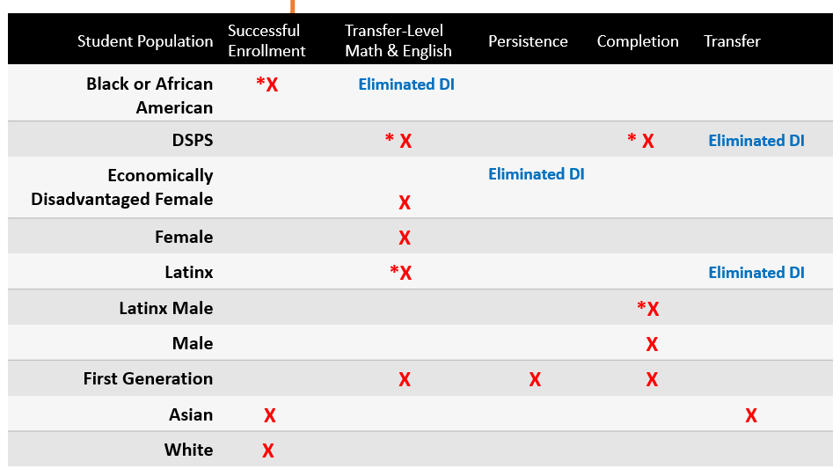
25-28 CSM SEAP Plan: Disproportionate Impacted Student Populations (General Overview)
*DI for same metric area in 22-25 SEAP plan
Foster Youth: Eliminated DI for Successful Enrollment (22-25 CSM SEAP)

Slide 9
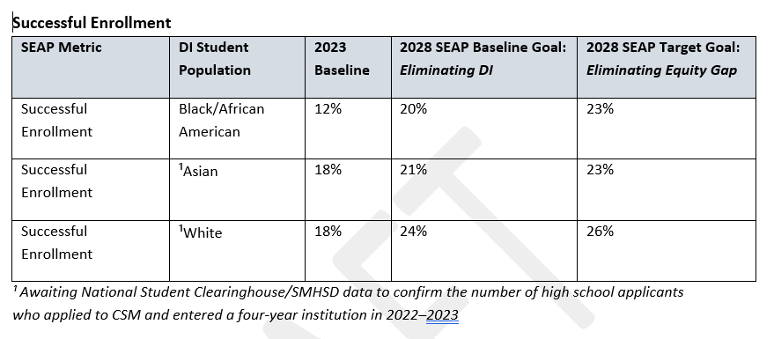
25-28 CSM SEAP Plan:
DI Student Populations, Baseline Data, and Baseline and Target Goals

Slide 10
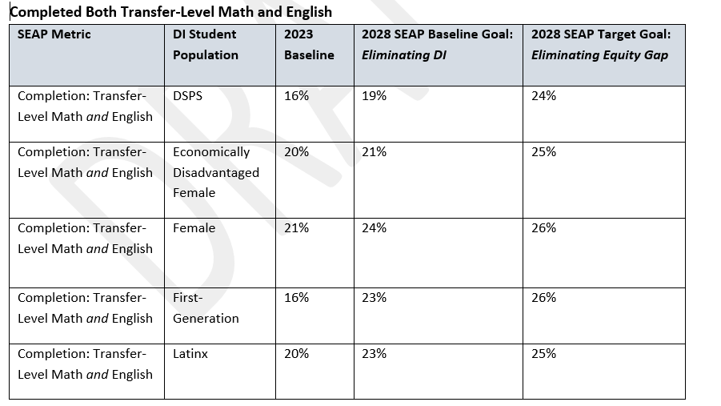

Slide 11
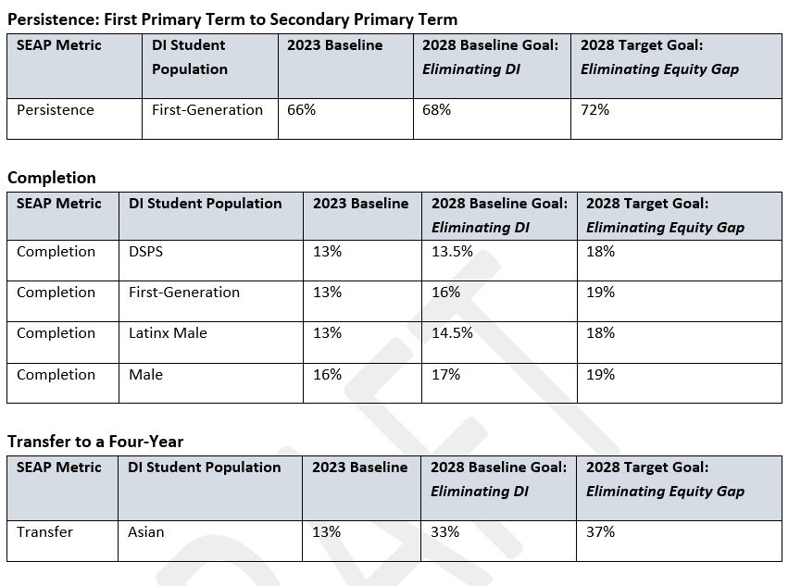

Slide 12
Equity Gaps and Root Cause
25-28 CSM SEAP First Draft

Slide 13
Analysis and Root Cause
  Persistent Gaps Identified (2025–2028):
    Continued disparities for Pacific Islander, Black/African American, Filipinx, and Latinx students in enrollment, persistence, completion, and transfer.
  Root Causes
    Inconsistent access to culturally responsive counseling and instruction
    Financial insecurity and complex onboarding systems
    Structural silos limiting coordination and accountability
    Insufficient integration of student voice in institutional decisions
  Student-Driven Insights
    Focus groups emphasized the impact of identity-based learning communities and caring, equity-minded faculty relationships.
  Action Response
    SEAP invests in equity-centered infrastructure, professional learning, and data-informed evaluation to transform systemic conditions, not just program outcomes.

Slide 14
Analysis and Root Cause
Key Institutional Findings (CSM-based data & surveys)
  In 2021–2022, CSM conducted antiracism surveys of students, faculty, and staff to assess perceptions of race equity, inclusion, and institutional culture. College of San Mateo+1
  The campus climate survey (Spring 2022; external ModernThink) unearthed challenges in diversity, inclusion & belonging, communication, and confidence in senior leadership as priority areas for growth. College of San Mateo
  CSM’s EMP “Reflection & Growth” process explicitly cites feedback from community listening tours and climate/antiracism surveys, highlighting concerns that “policies, practices, and curricula … have not led to equitable outcomes” and need re-examination. College of San Mateo+1
  Prior student equity planning documents note that LGBTQ+ / nonbinary students have been historically undercounted or left unrecognized in data due to constraints in state MIS (which is binary by default), limiting visibility of their equity gaps. College of San Mateo

Slide 15
Analysis and Root Cause
Identified Root Causes (per CSM and student feedback)
  Institutional & Structural Barriers
    Inconsistent access to culturally responsive mentorship, counseling, and academic support (especially for DI groups)
    Siloed program structures and limited cross-divisional coordination reduce accountability for equity outcomes
    Policies and resource allocations often fail equity impact review, perpetuating status quo inequities
  Curricular & Pedagogical Factors
    Incomplete integration of culturally sustaining or liberatory pedagogies into standard curricula
    Lack of consistent professional development, training, and accountability around antiracism and equity for faculty/staff
  Student Experience & System Navigation
    Complex onboarding, enrollment, financial aid, and registration systems pose barriers (especially for first-gen, nontraditional, multilingual students)
    Financial insecurity, work–school balance, housing/transportation constraints reduce persistence
    Students report insufficient representation, mentoring, and responsive support for overlapping identities (e.g. race + queer identity, veteran status)
  Data & Voice Gaps
    Gaps in how student identity is collected (e.g. MIS limitations regarding LGBTQ+ identities) reduce visibility of some equity gaps College of San Mateo
    Uneven use of disaggregated data, student voice, and feedback loops in decision making
    Underutilization of qualitative feedback (listening sessions, focus groups) as a complement to quantitative data

Slide 16
25-28 CSM SEAP Goals and Priority Strategies
25-28 CSM SEAP First Draft

Slide 17
25-28 CSM SEAP Goals
2025-2028 SEAP Goals
  Close equity gaps for identified DI student populations.
  Enhance sense of belonging, engagement, academic mindset and performance for DI student populations.
  Strengthen academic and student support infrastructure to better serve DI student populations.
  Build institutional capacity for equity-centered professional learning and continuous improvement.

Slide 18
25-28 CSM SEAP Priority Strategies
2025-2028 SEAP Priority Strategies
  Strengthen culturally sustaining pedagogy and coordination across learning communities.
  Expand mentorship and counseling opportunities across DI populations.
  Redesign onboarding and outreach strategies to improve equitable access and address successful enrollment gaps.
  Implement equity-focused evaluation using Office of Equity dashboards and student voice data.
  Integrate professional development for classified professionals, faculty, and student staff to strengthen equity competencies.

Slide 19
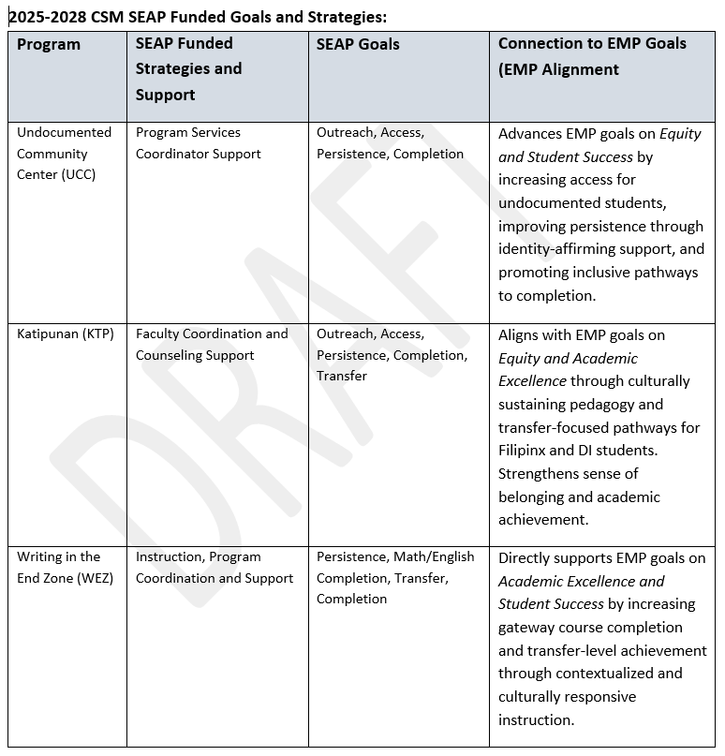

Slide 20
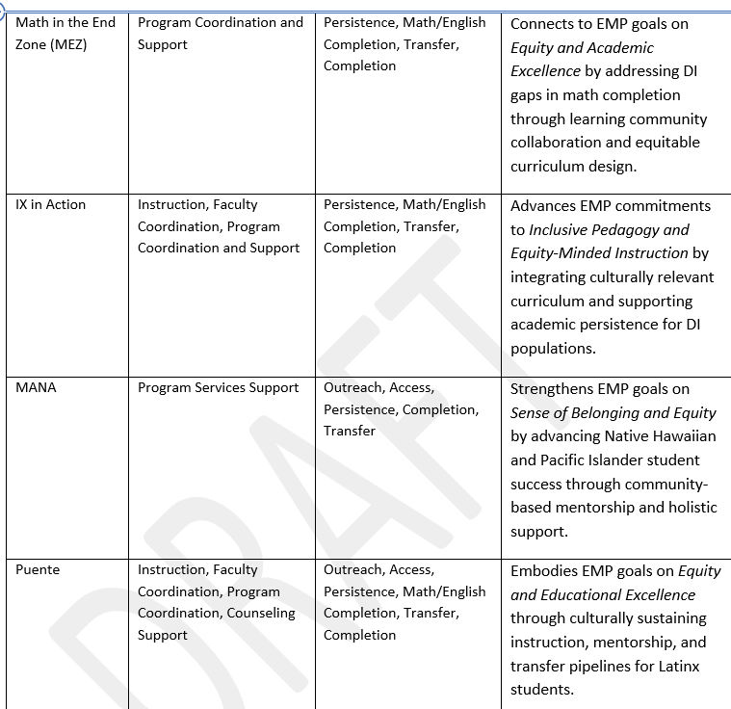
Program
Strategies/Support
SEAP Goals
EMP Alignment

Slide 21
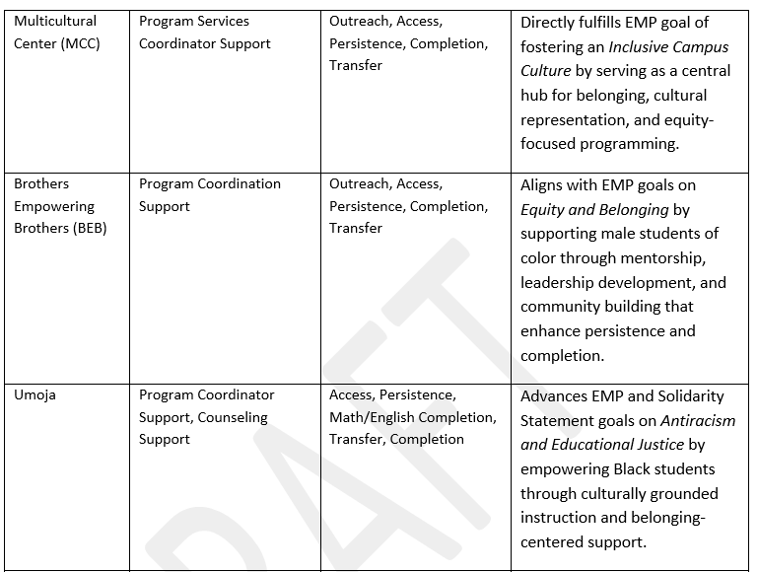
Program
Strategies/Support
SEAP Goals
EMP Alignment

Slide 22
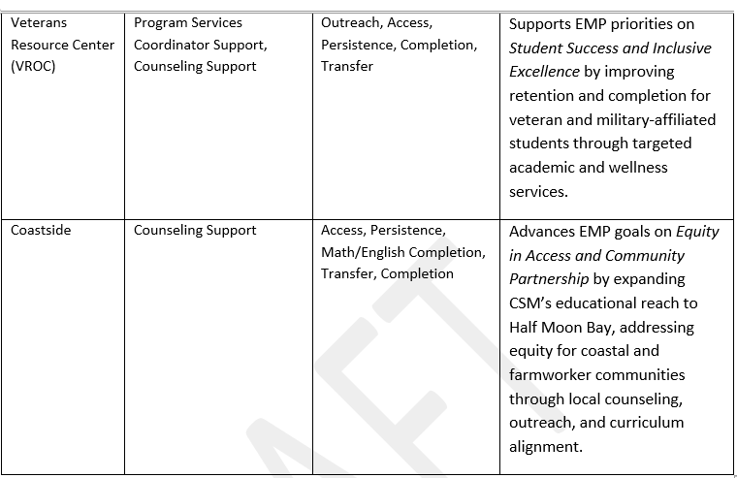
Program
Strategies/Support
SEAP Goals
EMP Alignment

Slide 23
SEAP Strategies and Goals
CSM Coastside: Building Equity on the Coast
Context & EMP Referenced Realities
  Coastside is Historically Underserved: The EMP calls out the Coastside region (Half Moon Bay, Montara, Moss Beach, El Granada, Princeton, Miramar) as “distinct … under-resourced” due to geography, limited transportation, and agriculture-based economy. College of San Mateo+1
  Economic & Resource Disparities: The EMP highlights that many Coastside neighborhoods have median incomes below $100K and lower rates of bachelor’s degree attainment, creating outreach gaps. College of San Mateo
  Physical & transportation barriers: Some students residing on the coast must travel up to 20 miles one way to reach the main campus, complicating access to in-person services. College of San Mateo
  Agriculture and migrant labor context: The EMP emphasizes an agricultural economy and presence of migrant farmworker population in Coastside, which informs barrier dynamics in enrollment, scheduling, and support services. College of San Mateo+1

Slide 24
CSM Coastside: Building Equity on the Coast on the Coast
Key Equity Focus Areas (Tied to EMP Realities)
  Careers & Workforce Pathways for Coastside
  Develop and align academic and CTE pathways tailored to local industries (agriculture, sustainable food systems, coastal/environmental sectors) to bridge education and local economy.
  Targeted Outreach to Migrant & Farmworker Communities
  Use multilingual, place-based outreach, flexible scheduling, and support services recognizing EMP’s identification of migrant labor communities as underrepresented.
  Coastside-Relevant Curriculum
  Offer courses reflecting the coastal, agricultural, and environmental context, increasing relevance and student engagement for Coastside learners.
  Enhanced Access & Recruitment
  Strengthen partnerships with Coastside high schools, community organizations, and local media to reduce distance and awareness barriers. In line with EMP’s goal to better serve underrepresented neighborhoods.
  Equity-Centered Counseling & Support at Coastside
  Embed counseling, academic advising, financial aid, and student support on-site or through hybrid models to mitigate geographic and resource constraints.

Slide 25
SEAP Strategies and Goals:
CSM SEAP Mini-Grants
Purpose
  Introduce a flexible, non-personnel funding mechanism that empowers academic departments, identity centers, learning communities, and student-facing offices to launch innovative, equity-focused initiatives.
  Advance the 2025–2028 SEAP and Educational Master Plan goals by strengthening collaboration, equity-minded innovation, and institutional learning.
Alignment with IEPI & EMP
  Builds on the IEPI Grant’s professional learning model and CSM’s Educational Master Plan by fostering innovation, collaboration, and sustainability in equity-driven practice.
(Some) Focus Areas for 2025–2028:
  Equity-Focused Professional Development: Continue and expand micro-courses, workshops, and coaching launched through the IEPI Grant.
  Language Access & Translation Services: Improve equity in communication by funding translation, outreach, recruitment, and marketing materials in multiple languages to reach historically underserved communities.
  Outreach & Enrollment Equity: Update enrollment forms, promotional materials, and digital outreach tools to better reflect CSM’s diverse communities.
  Data-Informed Pilot Projects:
  Support innovative, evidence-based projects that use disaggregated data and student voice to test scalable equity solutions.

Slide 26
SEAP Strategies and Goals:
CSM SEAP Mini-Grants
Intersectional & Coalition-Building Criteria
Mini-grant proposals will be prioritized if they:
  Center Equity and Antiracism through an Intersectional Lens:
  Address multiple, overlapping systems of marginalization (race, gender identity, sexuality, disability, veteran status, socioeconomic class, immigration experience, etc.).
  Foster Coalition-Building and Collaboration:
  Encourage partnership between programs or communities that don’t often intersect (e.g., collaborations between the Pride Center, VROC, Umoja, and MCC).
  Uplift Historically Underrecognized DI Populations:
  Create intentional visibility, programming, and research around communities not currently named in SEAP metrics, such as LGBTQIA2S+ students, veterans, foster youth, adult learners, etc.
  Promote Institutional Belonging:
  Contribute to a campus culture where all students, staff, and faculty see themselves represented in the college’s equity ecosystem.
  Demonstrate Sustainable, Scalable Impact:
  Pilot ideas that can later be institutionalized or replicated across other programs or divisions.

Slide 27
Coordination with Existing Campus Plans
25-28 CSM SEAP First Draft

Slide 28
SEAP and EMP
  Operationalizes EMP’s core institutional commitments to Antiracism & Equity, Teaching & Learning, and Accessible Student-Focused Support through measurable goals focused on closing equity gaps and eliminating disproportionate impact (DI).
  Antiracism as an Institutional Framework
    Embeds antiracist practices into teaching, counseling, and student support. Directly aligned with EMP objectives to dismantle systemic inequities and address anti-Blackness.
  Guided by Culturally Sustaining Pedagogy
    Learning Communities support advance culturally sustaining pedagogy that values students’ lived experiences, reflecting the EMP’s call to integrate identity, belonging, and justice into all learning environments.
  Capacity Building for Continuous Equity Work
    Through IEPI-funded professional development and SEAP Mini-Grants, the plan strengthens equity competencies among faculty, staff, and administrators, fulfilling the EMP’s goal of fostering an inclusive campus culture and data-informed improvement.

Slide 29
SEAP and our Solidarity Statement
  Centering BIPOC Student Success
    Prioritizes Pacific Islander, Black/African American, Filipinx, and Latinx students reflecting the Solidarity Statement’s commitment to address anti-Blackness and dismantle systemic inequities affecting Students of Color.
  Commitment into Action
    The SEAP Plan gives life to the Solidarity Statement’s call for institutional accountability, racial healing, and justice by embedding antiracism into funding priorities, programs, and evaluation.
  Investing in Identity-Based Centers
    SEAP-funded centers (e.g., Multicultural Center, Undocumented Community Center, Umoja, BEB) embody solidarity through spaces that cultivate belonging, representation, and leadership.

Slide 30
SEAP and Other Plans
IEPI & Professional Development
  SEAP and IEPI jointly build equity-centered capacity and professional learning for faculty, classified staff, and student employees.
Districtwide Vision 2030 & Strategic Plan
  Reinforces district priorities for equitable access, completion, and workforce preparation.
Guided Pathways Integration
  SEAP embeds equity across connection, entry, progress, and completion, enhancing student journey redesign.
Basic Needs & Financial Wellness
  Collaboration with SparkPoint ensures holistic student support through integrated academic and financial wellness resources.

