Slide 1
effective communication
critical thinking
quantitative reasoning
taking assessment beyond the classroom

Slide 2
No man is an Iland, intire of itselfe; every man is a peece of the Continent, a part of the maine….

Slide 3
guided pathways: starting with student goals
Notes:
Think for a minute about assessment

Slide 4
learning outcomes:
a promise to students
BUSINESS ADMINISTRATION ASSOCIATE IN SCIENCE DEGREE FOR TRANSFER (AS-T)
Program Learning Outcomes: Students completing this program will be able to:
Prepare and analyze financial statements.
Prepare and manage an operating budget.
Evaluate the impact of current economic conditions on a business.
Assess the legal implications of business decisions.

Slide 5
interdisciplinary learning goals
(institutional learning outcomes)

Slide 6
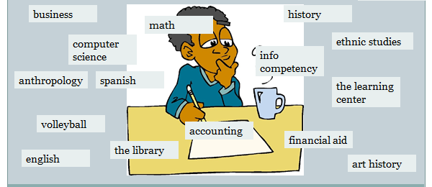
milestones along the way

Slide 7
constant assessment
What do students take away from BUS 100?
What do students take away from this interaction in the Learning Center?

Slide 8
in discrete bubbles
counseling
admissions & records
language labs
ART 251
ENGL 110
wellness
MATH 100
transfer services
CIS 120
CRER 101
learning center

Slide 9
we need another perspective
does our work with students, collectively, fulfil the promise laid out in the institutional learning outcomes?
Notes:
Frin the perspective that makes most sense to the student

Slide 10
No man course or service is an Iland, intire of itselfe; every man course or service is a peece of the Continent, a part of the maine….

Slide 11
seeing your course/service in context
three teams, each assigned to assess one outcome
team members
discuss what this outcome means in their disciplines/services
create an interdisciplinary rubric to assess the outcome
use this rubric to assess one assignment in F18
return results to the SLOAC
follow-up flex discussion in January (open to all)

Slide 12
REFLECTION (5 minutes)
Which of these three outcomes do your courses/services most directly support?
Think about a specific assignment or activity you are planning to use this semester which contributes to one (or more) of these outcomes. Jot down some details.

Slide 13
PICK A TEAM! (10 minutes)
Join colleagues to discuss a particular outcome.
Describe what this outcome means to you, in your work with students.

Slide 14
CREATE A RUBRIC! (40 minutes)
The rubric form you have is a template. Discuss the wording until you feel you have something that can be used to assess student work in all your courses. This means
finding common ground
making room for everyone
distinguishing between levels of competence

Slide 15
go the full five
 | 1 significantly below expectations | 2 developing competence | 3 competence | 4 exceeding expectations | 5 significantly exceeding expectations
Comprehend, interpret, and analyze written and oral information | Does not read assigned texts Does not grasp main idea | Reads assigned texts applies strategies to determine main idea | Reads assigned texts Understands main idea Draws inferences from main idea | Reads assigned texts Understands main idea Draws reasonable inferences from main idea | Reads assigned texts Understands and critiques main idea Emerges with new idea

Slide 16
or use a simplified 1-2-3
 | 1 significantly below expectations | 2 | 3 competence | 4 | 5 significantly exceeding expectations
Comprehend, interpret, and analyze written and oral information | Does not read assigned texts Does not grasp main idea |  | Reads assigned texts Understands main idea Draws inferences from main idea |  | Reads assigned texts Understands and critiques main idea Emerges with new idea

Slide 17
CREATE A RUBRIC! (40 minutes)
The rubric form you have is a template. Discuss the wording until you feel you have something that can be used to assess student work in all your courses. This means
finding common ground
making room for everyone
distinguishing between levels of competence

Slide 18
SHARE-OUT (20 minutes)
what did you disagree over?
where did you overlap?
do you see potential for interdisciplinary collaboration?
any last questions/observations?

