Slide 1
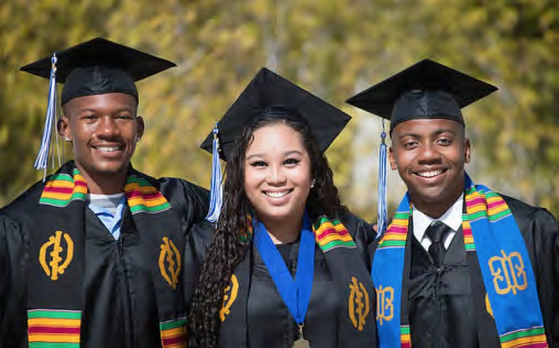
CSM Student Equity Plan -
Building an Equity Framework
Henry Villareal, Co-Chair, Diversity in Action Group, Dean of Enrollment Services
Theresa Martin, Co-Chair, Diversity in Action Group, Professional Development Coordinator, Professor of Biology

Slide 2
Why Student Equity?
From the Academic Senate’s 1992-93 “Guidelines for Developing a Student Equity Plan”
... It matters to our future and to our students… California will not be a pleasant place to live for any of us if a permanent underclass largely composed of those from ethnic minorities has little stake in society and little hope for the future. We can now easily see how economically weak and socially explosive such a society would be. If community colleges work successfully in the effort to increase rates of student success, the State just might have a better future. If we fail, it is hard to imagine who else can make up for our failure.
Notes:
Linda
We actually stole this quote from Debbie DiThomas’ presentation which was taken from one of the first CCC Academic Senate papers on Student Equity, first of all because we really like it, but secondly because it really sums up quite well why working to improve student equity matters not only to students but to us, our communities and to the State as a whole.

Slide 3

Successful Course Completion Rates
Source: Diversity in Action Group Assessment of Student Achievement/Equity Gap, March 2013

Slide 4
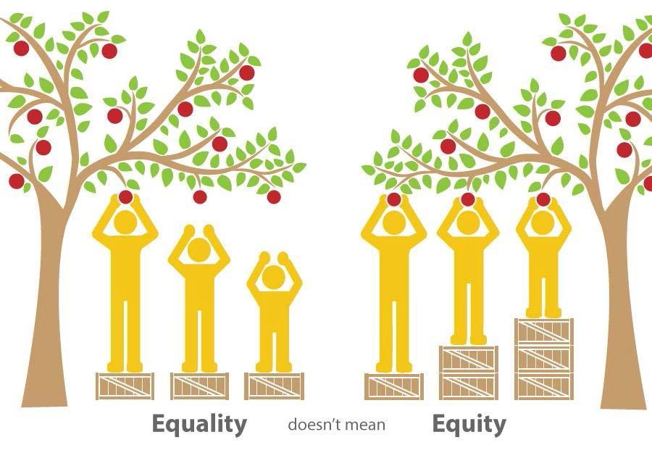
Commitment to Equity
Notes:
Thanks to
VERONICA A. K. NEAL, ED.D.
DIRECTOR (PREFERRED PRONOUNS: SHE/HER/HERS) OFFICE OF EQUITY, SOCIAL JUSTICE, AND MULTICULTURAL EDUCATION DE ANZA COLLEGE

Slide 5
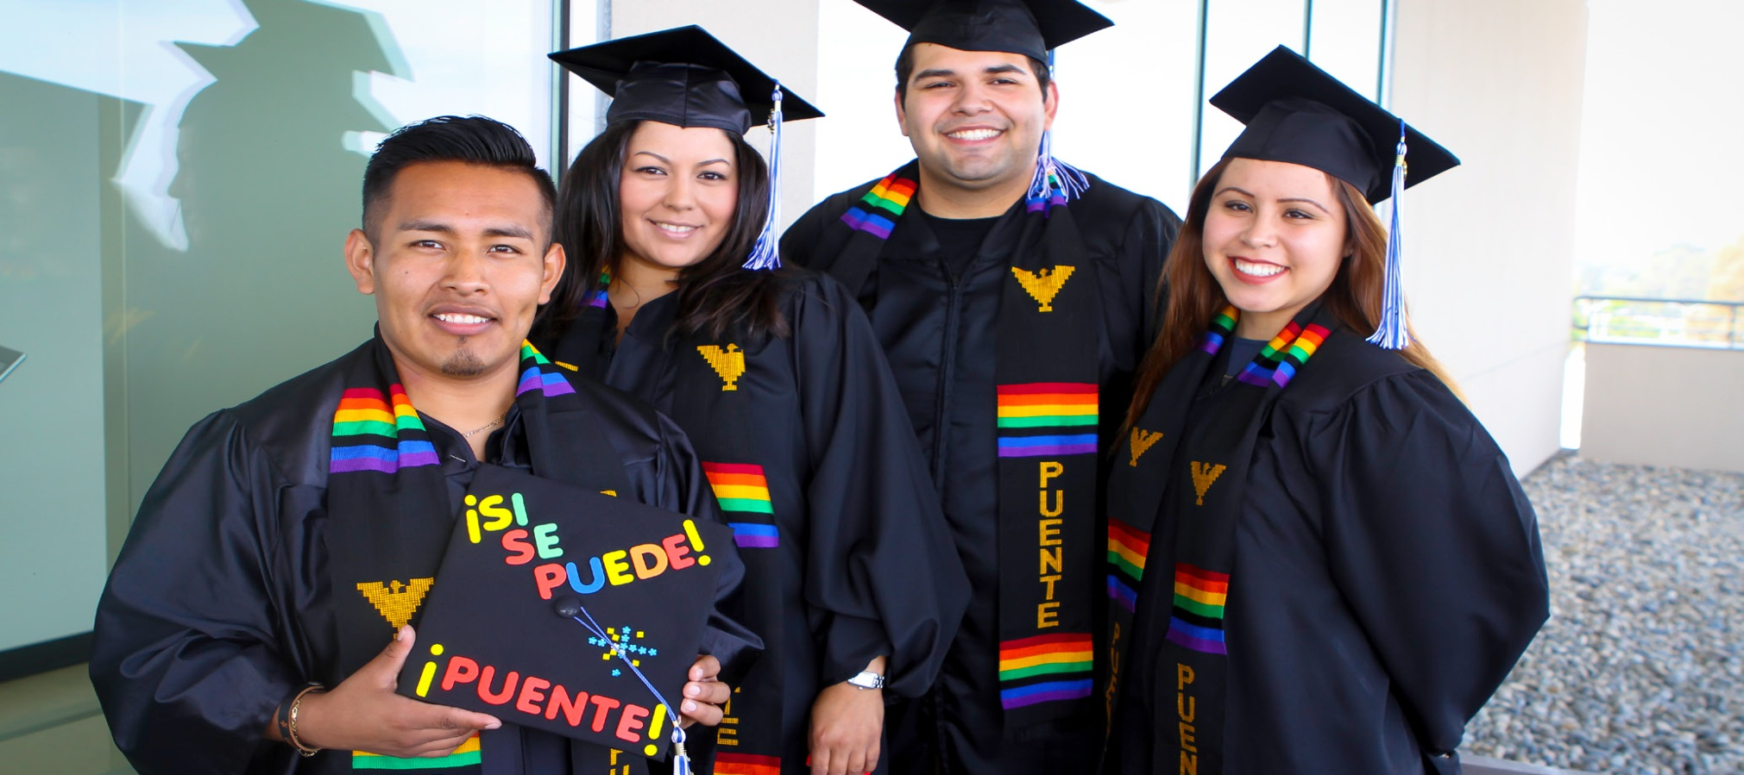
Student Equity Plan
Success Indicators
Access
Course Completion
ESL and Basic Skills Completion
Degree and Certificate Completion
Transfer
Notes:
Debbie Sheldon
Student equity planning is a college or district-wide planning effort that focuses on increasing access, course completion, ESL and basic skills completion, degrees, certificates and transfer for all students as measured by success indicators linked to the CCC Student Success Scorecard, and other measures developed in consultation with local colleges. “Success indicators” are used to identify and measure areas for which disadvantaged populations may be impacted by issues of equal opportunity. Each college develops specific goals/outcomes and actions to address disparities that are discovered, disaggregating data for indicators by student demographics, preferably in program review. College plans must describe the implementation of each indicator, as well as policies, activities and procedures as they relate to student equity at the college.

Slide 6

Student Equity Plan: CSM Target Populations
Success Indicator | Underserved Populations at CSM
*Access | Asian, Veterans, Hispanic or Latino
Course Completion (Retention) | Foster Youth, Black or African American, Native Hawaiian or Other Pacific Islander, Hispanic or Latino
ESL and Basic Skills Completion | Veteran, Multi-race, White, Hispanic or Latino
Degree and Certificate Completion | Multi-race, Males, Native Hawaiian or Other Pacific Islander, Filipino, Foster Youth
Transfer | Hispanic or Latino, Filipino, Disabled, Black or African American
*Determining impacted target populations includes the College’s service area, but CSM’s students extend beyond its immediate service area and county. College data highlight that, in 2014-15, more than 17% of students were from outside jurisdictions. Disaggregation by ethnicity of this group present significant numbers of historically underserved populations, including Asian, African American, Filipino, Hispanic or Latino, Multi-race, and Pacific Islanders. Outreach efforts to these populations will be conducted to include these groups.
In addition to prescribed target populations, other groups identified as being underserved are incarcerated youth, LGBTQ+, and undocumented students.
Notes:
Based on our research the following populations are underserved at CSM. Equity gaps were identified for eleven of fifteen target populations outlined in Student Equity Plan Guidelines. The Hispanic or Latino group was represented in four of five success indicators, with African American, Pacific Islander, Foster Youth, Filipino, and Multi-race groups identified as being underserved in two of the success indicators. Asian, Veterans, and Individuals with Disabilities were identified as having a disparity in only one success indicator. In addition to prescribed target populations, other groups identified as being underserved are incarcerated youth, LGBTQ+, and undocumented students; these student populations often contend with additional challenges of bullying, harassment, stigmatization, and marginalization.
*Determining impacted target populations includes the College’s service area, but CSM’s students extend beyond its immediate service area and county. College data highlight that, in 2014-15, more than 17% of students were from outside jurisdictions. Disaggregation by ethnicity of this group present significant numbers of historically underserved populations, including Asian, African American, Filipino, Hispanic or Latino, Multi-race, and Pacific Islanders. Outreach efforts to these populations will be conducted to include these groups.

Slide 7
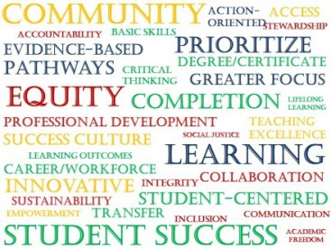
Where do the inequities emerge on the path to completion?
Preliminary findings from one large California District
Service Area Population
Enroll at Community College
Assess as College Ready
Credential Seeking Course Taking
Sufficient Academic Performance
Obtain Completion Credential
0% - 5 %
50% - 55 %
15% - 20 %
20% - 25 %
Not much inequity is observed through the lens of our traditional access measure.
The biggest driver of inequity in outcomes emerges here
We need to place some sustained attention on pathways and milestone completion
Our traditional approaches just might be widening the gap.
Notes:
From Gregory Stoup’s presentation. He is

Slide 8
Coordination: CSM Instruction and Student (Support) Services
Instruction and Student Services
Learning Communities
Supplemental Instruction
DSPS
DIAG/Equity
BSI
Project Change
Honors Program, etc.
Academic and Social Integration of Students
Learning Communities
Field Trips
The Village
DIAG/Equity
Guest Speakers
Cultural Events
Student Government
Clubs, etc.
Support Services
Counseling
Learning Center
Financial Aid
Psychological Services
VROC
International Student Center
Learning Support Center
Transfer Center
EOPS
Multicultural Center
Health Services
Food Pantry

Slide 9
Student Equity Learning Communities
Puente – Focuses on the Latino experience
Umoja – Focuses on the African American Experience
Mana – Focuses on the Pacific Islander Experience
Writing in The End Zone – Focuses on Student Athletes
Project Change – Focuses on Incarcerated Youth
Students for Success – Focuses on ENGL 838/848 students
Honors Project

Slide 10
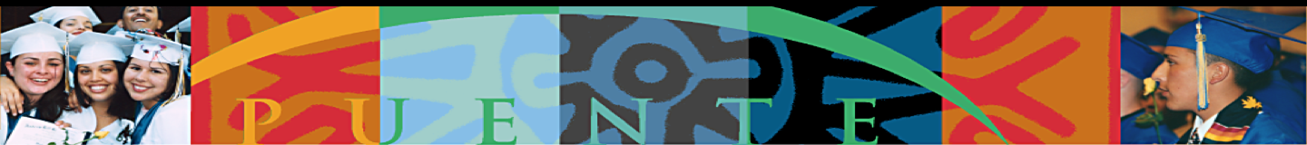
CSM progression beyond Basic Skills,
Spring 2013 – Fall 2013
Notes:
Carino means caring, and familia, family

Slide 11
CSM’s Equity Plan Focus
Focus on course completion & basic skills completion
Augment existing exemplary programs
Provide well-aligned and proactive student support services
Provide professional development on culturally responsive practice
Experiment with ways to improve student success
Assess activities for impact and opportunities for improvement
Notes:
Modified from:
CCRC studied High and low-impact Florida CC’s*
*Community College Management Practices That Promote Student Success, Jenkins, 2006
The study compared the policies and practices of Florida community colleges that have a high impact on the educational success of especially, their African American and Latino students with colleges that have a low impact. The colleges they studied were roughly comparable in terms of size, urbanization and student demographics. Based on literature, they assumed that colleges that had an impact would do some or all of these things. But they weren’t sure which ones were the most important for really helping these students succeed.

Slide 12
Acknowledgments
Diversity In Action Group/Equity Committee
Sylvia Aguirre-Alberto, Counseling
Patricia Brown, Student
Tabitha Conaway, Learning Center
Kristin Dempsey, CA Institute for Behavioral Health Solutions
Lorena Gonzalez, Counseling
Fauzi Hamadeh, Student Life and Leadership
James Howard, Peninsula Vet Center
Theresa Martin, Co-Chair, Biology
Lee Miller, Political Science
Kate Motoyama, Communication
Fi Tovo, Mana Program
Krystal Romero, Student Support Services
Annie Theodos, Academic Support Learning Technologies
Makiko Ueda, Psychological Services
Henry Villareal, Co-Chair, Enrollment Services
Marco Zavala, Student

Slide 13
Acknowledgments
Community Colleges League of California
CCCChancellors Office
Veronica A. K. Neal, Ed.D. Director (Preferred Pronouns: She/Her/Hers), Office Of Equity, Social Justice, and Multicultural Education, De Anza College
Gregory M Stoup, Vice President, The RP Group Board. Senior Dean, Contra Costa Community College District
Puente Program Coordinators, Lorena Gonzalez and Jon Kitamura

